Slide 1
Components of a Processor
Switches, Gates, and Some History
© 2018 L. V. Kale at the University of Illinois Urbana-Champaign

Slide 2
To be able to effectively program a modern multiprocessor, we have to understand what it is made up of and how it came to be the way it is today

Slide 3
What Are Computers Made of?
Building blocks of computers
Why has frequency scaling stalled?
Conception of parallel computing
Machine organization
……..
Complexity of modern processors makes performance oriented programming challenging

Slide 4
A Computer today is a powerful machine
We have been able to make a “machine” that can do complex things
Weather forecast, design of medicinal drugs
Speech recognition, robotics, artificial intelligence
Web browsers, Internet communication protocols
What is this machine based on?

Slide 5
The Modest Switch
All these capabilities are built from an extremely simple component:
A controllable switch
The usual electrical switch we use every day
Turns current on and off
But we need to turn it on and off by hand
The controllable switch
Voltage controls if the switch is on or off
High voltage at input: switch on
Otherwise it is off

Slide 6

Let’s Use Them Creatively
Input1
Output is high if both input1 AND input2 are high
If either of the inputs is low, the output is low
Output
This is called an AND gate
Input2
Now, can you make an OR gate with switches?

Slide 7
OR Gate
Input1
Output
Input2
Output is high if either Input1 OR input2 (or both) is high

Slide 8


Basic Gates
There are three basic kinds of logic gates
Operation:
AND
of two inputs
OR of two inputs
NOT
(complement)
on one input
Logic gate:
Two questions:
How can we implement such switches?
What can we build with gates?
Adders, controllers, memory elements, computers!

Slide 9
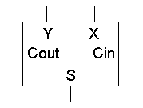
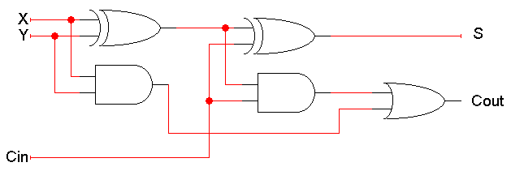
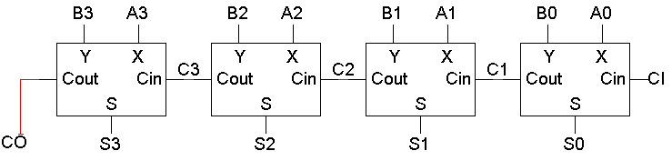
You Can Make an Adder with Gates
Full adder (with carry)
xor
4 bit adder

Slide 10
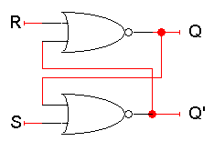
How About Some Memory?
Switches help us build memory
How can a circuit “remember” anything on its own?
After all, the values on the wires are always changing, as outputs are generated in response to inputs
The basic idea is feedback: we make a “loop” in the circuit, so the circuit outputs are inputs as well
When S and R are 0, Q is “stable”: whatever it was, it stays in that state
Ergo: memory
When S is 1 and R is 0, Q becomes 1
When R is 1 and S is 0, Q becomes 0
Set and reset inputs…

Slide 11
Components of a Stored-Program Computer
Instruction Memory
Data Memory
PC (Program Counter)
Move to the next location
Register set
ALU
Instruction

Slide 12
How computers are built from switches/gates is a matter for other courses
For this course, remember:
Computers are made from some very simple components by putting a large number of them together in interesting ways, and running them really fast
Notes:
End Video Here.

